Slide 1
Solar Energy
2018
Lesson 5 – Advanced Level
www.teachpeel.ca

Slide 2
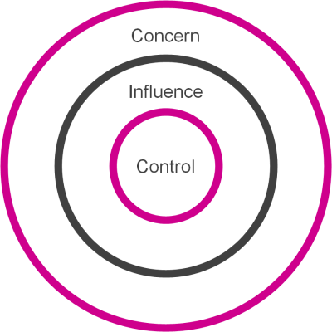
Circle of Concern, Control and Influence
Circle of concern - things we may not have direct control over.
Circle of influence - things that I can influence and others can do something.
Circle of control - things I can actually do
Notes:
It can be easy for kids to become overwhelmed by the issue of climate change. Using the circle of control, influence and concern helps students to discern what they can affect.
This lesson is focused on the circle of concern.

Slide 3
Introduction to Solar
Did you know that solar PV is the only type of electricity that doesn’t require moving parts?
Notes:
I this lesson, we will explore all things related to solar energy. There are two primary uses of solar energy that we will explore: Solar Photovoltaic (PV), and Solar Thermal.
By the end of the lesson, students should understand the difference between solar PV and solar thermal. They should also be able to identify they different technologies.

Slide 4
Solar energy is derived from the sun!
We measure the sunlight as solar irradiance which is the amount of power per unit area

Slide 5
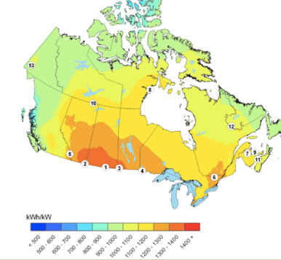
Solar Resource in Alberta
Yearly PV Potential, KWh/kW
The solar resource in Alberta is world class!
See how the resource in Calgary, Edmonton and Regina compare to the rest of the world!
http://pv.nrcan.gc.ca
Notes:
As the graph on the right shows, Alberta has high solar potential. The Solar resource in Calgary is comparable to the resource in Brazil, Rome, Sydney!
This means that Alberta can generate a lot of electricity from solar. Since we have a high solar resource, the production and total energy produced will be higher than places with a low resource. Therefore, Alberta is better suited for solar in Canada than places like the territories.
Solar Irradiance:
Definition from NASA – “irradiance is the amount of light energy from one thing hitting a square meter of another each second”
In other words, irradiance tells use how much energy can be generated from the sun per unit area.
We measure the solar irradiance with a device called a pyranometer.

Slide 6
Solar Cost Has Reduced by 86% since 2009
Notes:
https://www.lazard.com/media/450337/lazard-levelized-cost-of-energy-version-110.pdf

Slide 7
Solar Energy Can be Used for Heating or Making Electricity
Heat
Electricity
Notes:
Solar Energy can be used by people for either heating (passive heating such as heating homes through windows, or solar walls, or heating hot water)
Or making electricity through solar photovoltaics.

Slide 8
Solar Technology
Notes:
Now we are going to take a close look at some solar technology.

Slide 9
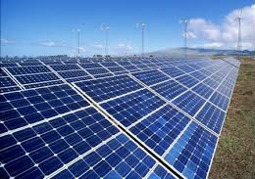
Types of Solar Technologies
Solar Photovoltaic (PV)
Concentrating Photovoltaics (CPV)
Concentrating Solar Power (CSP)
Solar thermal
Notes:
There are four types of technologies that use energy from the sun to operate. Solar PV, CSP and CPV all use the sun’s energy to generate electricity. Solar thermal on the other hand, uses the sun’s energy for heating purposes. Solar thermal is commonly found on houses, and is not generally used at large scale.
Both CSP and CPV use light from the sun and concentrate it onto one spot. This concentration makes the light extremely hot and can be dangerous to workers if precautions are not taken. These types of solar are not common in Alberta - they are usually found in the desert.
CSP works by using mirrors or lenses to focus a large area of sunlight into a smaller area (see the pole in the picture).
CPV works by focusing the sunlight (with lenses or mirrors) onto small solar cells. This technology is usually installed with a tracker system so that the unit can follow the sun’s movement and generation can be optimized.
This lesson will focus on solar PV and solar thermal, which are technologies that are already present in Alberta, and more will be installed in the near future.

Slide 10
Making Electricity from the Sun Solar Photovoltaics (PV)

Slide 11
Solar PV Terminology
6 cells
Multiple modules form a panel
One solar cell
12 cells
Solar Array
Multiple panels form an array
One solar module
There are 72 solar cells in this module
Notes:
A solar cell is the smallest individual unit in solar PV.
Solar panels and solar modules are sometimes used interchangeably, but there is a key difference. The term panel means multiple modules connected together. An array is when the panels are connected to a power source. An array is made of multiple panels, or modules connected together.

Slide 12
What is Solar Photovoltaic (PV)?
Solar cells!
Solar PV converts energy from sunlight to electrical energy.
Many calculators have solar cells in them!
Did you know:
The sunshine on the Earth’s land is estimated to be 120,000 terawatts or about 6,000 times the world's estimated 20 terawatt electricity demand by 2020.
- National Geographic
Notes:
At a high level, solar PV converts the energy from the sun’s light into electrical energy that can be used for our purposes. You can find solar PV in many everyday objects such as in calculators. The cells in calculators prolong the life of the calculator without needing to change the battery frequently.

Slide 13
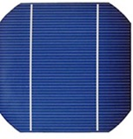
How does a solar cell work?
A solar cell is made up of two types of silicon
N-type
Favours the gain of electrons
P-type
Favours the lack of electrons
Photons from the sun strike the n-type silicon, which releases free electrons
Free electrons flow from the p-type to the n-type
“Holes” are formed in the p-type
The electron imbalance generates a current and electricity is then generated!
Watch this video to see a visual of how this process works:
https://www.youtube.com/watch?v=epFsYcDNxjQ
Photons from the sun
Electron Negative – N-type
Junction
Electron Positive – P-type
Side view of a solar cell
Notes:
Within each individual cell on a module, there are two layers of silicon. The top layer is called the n-type silicon, which has a preference of being negatively charge. The n-type has an excess amount of electrons, which can freely move throughout the layer. The bottom layer is called the p-type silicon, which has a preference of being positively charged. The positive charge is due to a lack of electrons in the layer. This forms “holes” in the layer where electrons would exist. Finally, between the two layers is a “junction”.
When a photon of light hits the n-layer, a free electron is pushed out of the layer. Electrons then move around to readjust to their original, preferred state. This movement of electrons creates a current, and the current creates electricity.
Here are some resources:
https://www.explainthatstuff.com/solarcells.html
http://www.physics.org/article-questions.asp?id=51
For a more detailed description, check out this video:
https://www.youtube.com/watch?v=UJ8XW9AgUrw

Slide 14
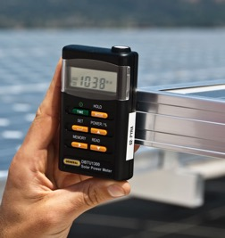
Solar Resource Measurements
A pyranometer is a device used to measure the intensity of the sun at any given time (also called irradiance)
Units: watts/m²
For accurate reading, point the sensor in the same direction the solar module faces
Notes:
This is a useful tool to predict the possible energy generation that a solar panel could produce. This device measure’s the sun’s irradiance and expresses this value in watts/m².
This slide shows two types of pyranometers. The picture on the left is a portable pyranometer, whereas the picture on the right shows a permanent pyranometer. This one is typically used to make sure the solar modules are producing electricity as expected.

Slide 15
Did you know….
China is the world leader in solar PV installed capacity by the end of 2016 (77.9 GW). Second is Japan (42.9 GW), third is United States (42.4 GW) and then Germany (41.1 GW).
Source: Solar Power Europe (2016).
Solar PV researchers are seeking to drive down the cost of solar PV cells by using new materials, looking at PV materials that can be painted on, and using geospatial software to design systems online. Impurities in silicon cause the free electron movement that creates electric current. Scientists are looking at newer and thinner materials, even solar ink or paint. Many companies are looking to reduce solar cost by enabling customers to design and order online.
The photovoltaic effect was identified by French physicist Alexandre-Edmond Becquerel when he noticed the effect when working with metal electrodes in an electrolyte solution in 1839.

Slide 16
Anatomy of a Solar Farm
Notes:
This is a picture of the Brooks Solar Farm in Alberta

Slide 17
Components at a Solar Farm
Notes:
This is what all the components at a solar farm look like together.
The largest component are the PV Arrays. This is what captures the energy from the sun.
Next are the inverter stations. These change the electric current from DC to AC.
Finally, we have the sub station. This is where all the generated electricity first goes to be distributed to different locations

Slide 18
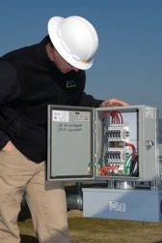
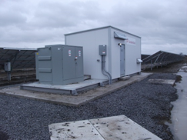
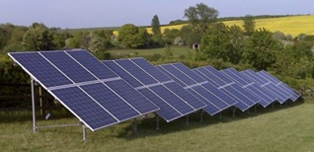
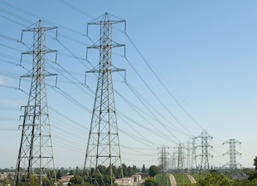
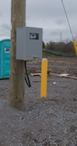
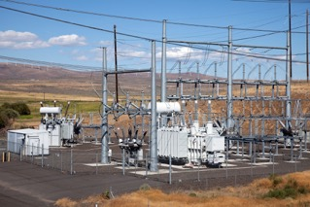
Energy Power Flow
Combiner Box
Inverter Station
DC
PV Array
AC
Utility Grid
Meter
Substation
Notes:
This slide shows the process the energy goes through from generation to delivery.
First the PV arrays convert the suns energy (thermal energy) into electrical energy. At this stage, the energy exists as direct current (DC). It then goes to a combiner box, which is where all the energy from all the panels go. The energy then goes to and inverter station which convers the DC electricity to alternating current (AC). The AC electricity then goes to a substation, followed by a meter. The final location the electricity goes in the utility grid, which delivers the electricity to consumers.

Slide 19
Balance of System (BOS) Components
Inverters
Racking/Mounting
Wiring/ Cabling
Central Inverters
Ground Mount
Wire/Cable
Single- and Dual-Axis Trackers
Combiner Box
Microinverter
Commercial Roof
DC/DC Optimizer
Residential
Notes:
Here is a summary of all the components required for a solar facility. On the following slides we are going to take a closer look at what each of these components are.

Slide 20
Inverters – Types
An electrical device that converts direct current (DC) to alternating current (AC)
Main types:
Central Inverter
String Inverter
Micro Inverter
Based on your array and setup, one inverter may be more beneficial than the other
Central Inverter
String Inverter
Micro Inverter
Notes:
The electricity produced from solar panels exists as direct current (DC). The inverters convert DC to AC because AC is able to travel long distances in transmission lines since the voltage can easily change levels.
The names AC and DC come from how the electricity flows (current). In AC, the current continuously changes direction, while DC remains in the same direction. (See the next slide for more details)
Central Inverters:
A single inverter is used for ALL modules.
This is the cheapest inverter you can buy.
This type is commonly used for large commercial, or utility scale solar
String Inverters:
This inverter connects to multiple modules that are in series (modules that are connected together)
This inverter in cheaper than a micro inverter
A downfall is that if the inverter fails, all the modules connects to it cannot operate. Rather with a micro inverter, if there is a failure, only the one module is affected.
Micro Inverters:
These connect to each module. Therefore, for each module, there is its own inverter to convert the current. With this type of inverter, you can monitor each module separately for any operating failures.

Slide 21
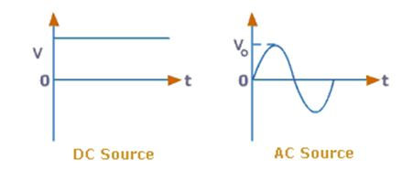
Inverters – AC/DC
Not the music band!
This describes the current’s flow
AC alternates directions causing “disruption” in flow
DC goes in the same direction continuously
Notes:
AC and DC notation are descriptors for how the current flows.
In AC, the current flows bidirectionally, whereas DC is in the same direction.
The graphs on this slide show how the current changes over time
Voltage is constant in DC and is changing in AC
As you can see, the AC graph takes on a sine/cosine shape.

Slide 22
Racking – Ground Mounted Solar PV
A ground mount system is directly anchored into the ground
Notes:
This is an example of a ground mounted solar PV system. The frame is anchored into the ground.
This type of racking system is stationary and has no moving parts.

Slide 23
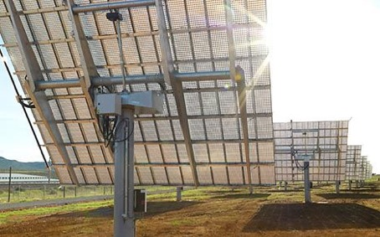
Racking – Trackers
Trackers are sometimes used to maximize the energy production
This racking equipment allows the solar PV modules to move with the sun
The can be single- or dual-axis
Dual-axis moves in all directions
SINGLE AXIS
DUAL AXIS
Notes:
The picture on the left is a single-axis tracker. This only moves east-west.
The picture on the right is a dual-axis tracker, which can move east-west and north-south. This type of racking allows for the best production as the panels can follow the sun throughout the entirety of the day without any down time.
Dual axis follows the sun – like a sun flower

Slide 24
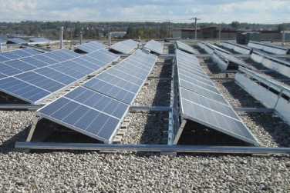
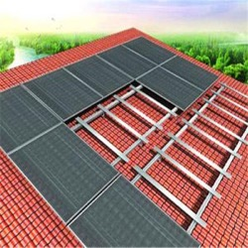
Racking – Roof Mounted Solar PV
FLAT ROOFS
PITCHED ROOFS
Modules installed at a angle to the roof
Mounted directly onto the roof
Ballasts may be used if roof can hold the added weight
Installed flush to the roof
Installed onto rails
Notes:
The racking systems on the last slides were all for ground mounted solar PV, and are usually used for large scale solar.
The racking systems on this slide are types you would use for roof top installations.
Trackers are not possible on roofs.
For roof top installations, you must first consider they type of roof: is the roof flat or pitched?
It is important to assess the roof before installing solar to ensure it can hold the weight of the panels. If it cannot, damage could occur, especially if ballasts (cement blocks) are used on flat roofs.

Slide 25
Wiring/Cabling – Types
SERIES CONNECTION
PARALLEL CONNECTION
Voltage is additive, Current remains the same
Connection is from +’ve to –’ve
Current is additive, Voltage stays the same
Connection is from +’ve to +’ve or –’ve to –’ve
Notes:
When wiring, you can connect the modules in series, or in parallel. Sometimes both are used.

Slide 26
Solar Cell Technology
CRYSTALLINE SILICON (cSi)
THIN-FILM
Monocrystalline and polycrystalline cells available
Monocrystalline modules 13-22%¹ efficient
Polycrystalline modules 12-18%¹ efficient
Most common type in the market
Cells are thin and flexible
Silicon and non-silicon available
Non-silicon: copper indium diselenide (CIS), and cadmium-telluride (CdTe)
Can be used as rooftop shingles
7-17%¹ efficient
Monocrystalline
Polycrystalline
Notes:
There are two main types of solar cells. The pictures on this slide are of the cells in a module.
Crystalline silicon is the main type used. It has the best efficiency. There are two types: monocrystalline and polycrystalline. Monocrystalline is they most efficient solar cell on market today. Although polycrystalline is still used.
Thin-film is another type of cell. It has a lower efficiency than the crystalline equivalent. This cell is flexible and can be mounted onto many surfaces. A common use is as shingles on a roof. This allows for the generation of solar energy without the need of large solar panels on a roof. For many, this option is more aesthetically pleasing, however, the generation in much lower that if crystalline panels were installed.
^{[1]} Solar Energy International – PV101: Solar Electric Design and Installation (Grid-Direct)

Slide 27
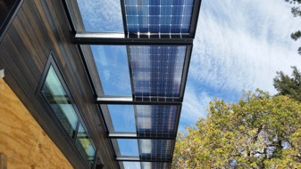
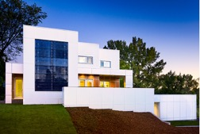
Solar Innovations
Bifacial Solar Modules
These modules produce power from both sides (top and bottom)
These are best suited when the bottom faces a highly reflective surface (i.e., light coloured stones)
Available in both mono- and polycrystalline cells
Solar Shingles
Designed by Tesla, available in 4 styles: Textured, Smooth, Tuscan, and Slate
These dual as solar panels and shingles, and are very strong.
Building Integrated Photovoltaics (BIPV)
These are frameless modules built directly into the building
Con sometimes replace windows or roof tiles (BIPV produces more power than solar shingles)
Notes:
Here are some new and upcoming solar technologies that are on the market today.
People generally choose these types of solar from a style and architectural point of view. Since these are all integrated into the buildings, they are not as noticeable. Although these are aesthetically pleasing, they are not as efficient as solar panels.
Bifacial modules source: https://www.solarpowerworldonline.com/2018/04/what-are-bifacial-solar-modules/
Solar Shingles source: https://www.tesla.com/en_CA/solarroof
BIPV source: http://www.skyfireenergy.com/building-integrated-solar-pv-systems-the-future-of-solar/

Slide 28
How to install solar panels
This is the beginning stage of solar installation. First, racks must be mounted for the panels to sit on
Racking system
Notes:
The first step of installing solar panels is to first install the racking systems. There are many types of racking systems used. The choice of racking used is dependent on the location. In this picture, this is a fixed racking system. Many solar facilities use this type. Fixed systems are also found on roof top installations. Lesson 5 provides more information on these systems.

Slide 29
Fixed Solar Racking
Notes:
This is an example of a fixed racking system, which is very common. When this is used, the solar panels do not move.

Slide 30
Completed Solar Farm in Alberta
This is a 2 MW PV system located in Bassano, Alberta (east of Calgary)
Notes:
This is a currently operating solar facility. The panels are mounted on fixed racking systems.

Slide 31
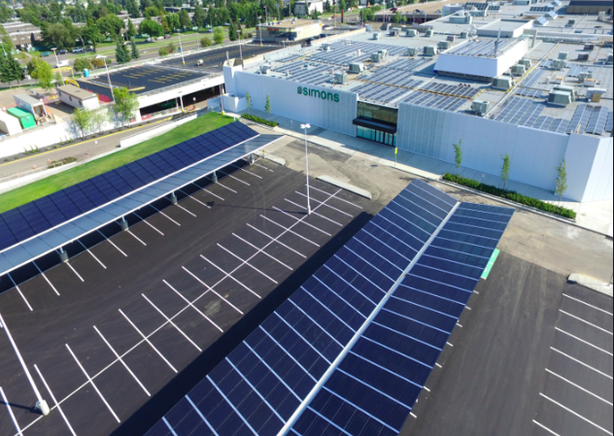
Here are some more examples of solar in Alberta!
This is the Simons store in Edmonton, Alberta
These are solar panels on a parking garage, and on the building roof
The entire system has a capacity of 636 kW

Slide 32
This was installed by SkyFire Energy
The solar panels are installed along the sides of the building

Slide 33
Solar panels can be integrated in to the architecture of a building for a cool look!
This was also installed by SkyFire, in Edmonton

Slide 34
Solar Thermal
Notes:
We are now going to look at solar thermal and how it is used for heating applications.

Slide 35
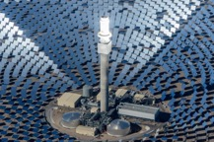
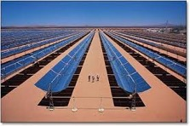
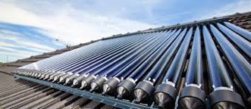
What is Solar Thermal?
Solar thermal uses heat from the sun for various heating and electrical applications.
Solar thermal works different that solar PV
It concentrates light from the sun to create heat, which is used to power a generator and make electricity
A liquid or a gas is used to power the generator
Solar PV on the other hand converts the energy from the sun from one form to another
Concentrating Solar Power (CSP) technologies are a solar thermal technology
Notes:
Check out the Solar Thermal 101 video by Student Energy
https://www.youtube.com/watch?v=FgjfJGfusdE
The primary use of solar thermal is for heating purpose. These are common on houses (see picture on the right).

Slide 36
Solar PV Case Study
Courtesy of Dr. Andrew Leach

Slide 37
Solar Panels on the Home of Dr. Leach
Notes:
Dr. Andrew Leach is a professor at the University of Alberta. On the rooftop of his home, he has an array of solar modules, shown in the picture on this slide. The content on the following slides are from a presentation provided by Dr. Leach

Slide 38
Power Generation – Month-to-Month Variation
Notes:
This is a tabulated graph of a years worth of power generation at the home of Dr. Leach. As you can see, there is fluctuation month-to-month in production. This is because there is a lot of variation in the weather. There is also a large seasonal impact. Spring and summer months generate more electricity than winter and fall months. Snow coverage has a large impact on this in the winter. Additionally, the sun irradiance is also much stronger in the spring and summer months.

Slide 39
Power Generation – Snow Impacts
Notes:
This graph shows the large impact the snow coverage has on a solar module’s power production. The spike in the graph is due to cleaning snow off the modules. Snow on the modules resulted in nearly a third of the total potential generation of that day.
From this, you can see how important it is to keep your panels clean of snow and dust! If not, you can significantly reduce your power generation, which could cost you money.

Slide 40
Quiz!

Slide 41
When was the first discovery that certain metals produced an electric current when exposed to light?
1752
1839
1911
1954
Notes:
Correct Answer is b) 1839

Slide 42
Which country has the most solar PV power, as of 2016?
Spain
China
Germany
The United States
Notes:
Answer is b) China

Slide 43
Which is NOT one of the ways researchers are seeking to drive down the cost of solar PV cells?
By removing impurities in silicon
With PV material that can be painted on
By using new materials
By using geospatial software to design systems online
Notes:
Answer is a). Impurities in the silicon actually enhance electricity generation.

Slide 44
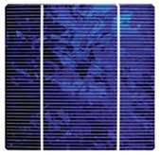
Identify the Cell Type
A)
B)
C)
Notes:
Monocrystalline
Polycrystalline
Thin-film

Slide 45
What does a Pyrometer measure?
Temperature of the sun
Temperature of the panels
Irradiance of the sun
Potential panel output
Notes:
Answer: C

Slide 46
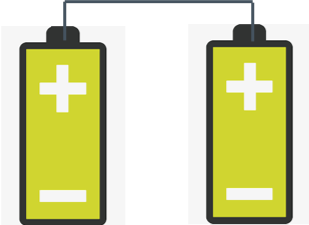
Identify if the pictures are in series or in parallel
Notes:
The top picture is in series – series connects from positive to negative
The bottom picture is in parallel – parallel connects from positive to positive

Slide 47
THANK YOU!
PEEL is supported by the Community Environment Action Program. This project is offered in partnership with GreenLearning Canada Foundation, provider of free online education programs about energy, climate change and green economy.

Slide 48
Activity
Solar Powered Ovens
Notes:
The solar related activity for this lesson is building a solar powered oven that can be used to cook a simple snack.

Slide 49
Build a Solar Powered Car or Solar Oven
See the handout for instructions!
https://desertchica.com
Notes:
This is a STEM related activity. Instructions are found in the lesson plan.

Slide 50
EXTENSIONS!

Slide 51
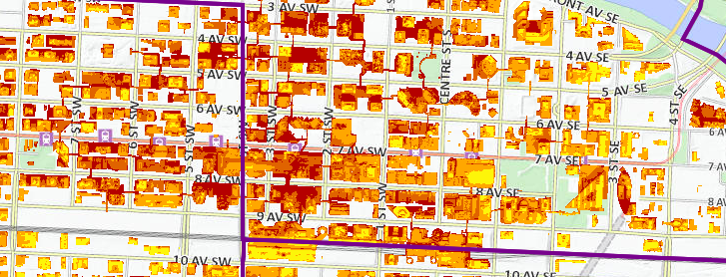
Assess the solar potential at your home, school, or favourite building!
https://maps.calgary.ca/SolarPotential/
Notes:
This is a website where students can look around and see how much solar power a building rooftop in Calgary can generate. Have the students play around and have fun!

