Slide 1
Wind Energy
2018
Lesson 6 – Advanced Level
www.teachpeel.ca

Slide 2
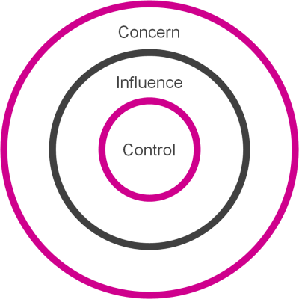
Circle of Concern, Control and Influence
Circle of concern - things we may not have direct control over.
Circle of influence - things that I can influence and others can do something.
Circle of control - things I can actually do
Notes:
It can be easy for kids to become overwhelmed by the issue of climate change. Using the circle of control, influence and concern helps students to discern what they can affect.
This lesson is focused on the circle of concern.

Slide 3
Video on Wind Energy
Wind Power 101 – StudentEnergy
  Published December 1, 2014
  This video is 1 min, 46 seconds
https://www.youtube.com/watch?v=Z5c50-_hcD0
Wind power is now the cheapest form of electricity
Notes:
Show the students this video so they gain a basic understanding of what wind is and how it works. Proceed to the following slides when complete.
To watch the videos linked in the presentations, click on the link while in PRESENTATION MODE

Slide 4
Alberta’s Wind Resource
One-third (1/3) of Alberta’s lands are more than sufficient for wind power
The red and blue areas on this map have high wind resource
The resource in the yellow areas is similar to the resource in Germany
Notes:
Alberta has lots of wind that can be used to generate electricity. The best wind is located in southern Alberta. One this map, the regions in Alberta with the highest wind speed is marked in blue and red. The rest of Alberta (shown in yellow) has a similar wind resource to Germany! Germany has a lot of wind farms.
In Alberta, most of our wind farms are located in central and southern Alberta. Have you seen any?
As the wind energy continues to grow, we could start to see wind farms in northern Alberta as well!
Did you know there is one wind farm in Alberta that has a capacity of 300MW! This wind farm is located north of Lethbridge.

Slide 5
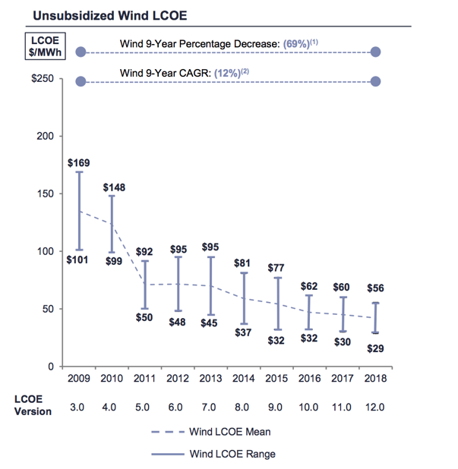
Wind Cost Has Reduced By 69% Since 2009.
The Compound Annual Growth Rate (CAGR) Has Been 12%.
Notes:
https://www.lazard.com/media/450784/lazards-levelized-cost-of-energy-version-120-vfinal.pdf

Slide 6
Wind Technology
Notes:
Now we are going to take a close look at some wind technology.

Slide 7
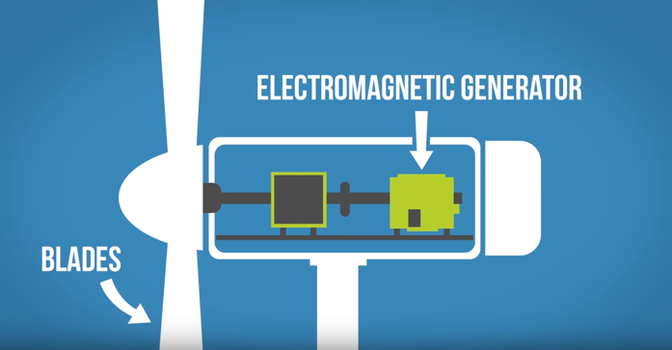
What is wind energy?
A wind turbine converts the wind’s kinetic energy into mechanical energy
A generator then turns this energy into electricity
Notes:
Picture from Student Energy - Wind 101 video.
The blades on a wind turbine turn to convert the kinetic energy in with to mechanical energy. The generator, which is found in the nacelle of the turbine, is the component responsible for making electricity.

Slide 8
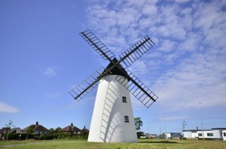
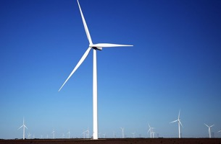
Windmills and Wind Turbines
They may seem the same, but they are very different
WINDMILLS
WIND TURBINES
Use the wind’s energy to grind grain and pump water
Has typically multiple blades (4 or more)
Use the wind’s energy to generate electricity
Has typically only 3 blades
Notes:
There is a lot of confusion between windmills and wind turbines, and it is a common mistake. Although wind turbines are modeled after windmills, which have been around for centuries, they both service very different purposed. See the comparison above to understand the difference. Wind turbines are also significantly larger in size (as high as 200m!).
For centuries, humans have used the wind to power their activities. Windmills and sailboats have helped us in our lives.
Windmills are used to grind grain and pump water.
Wind turbines produce electricity

Slide 9
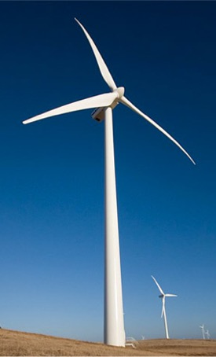
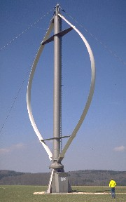
Types of Turbines

Slide 10
VAWT Turbines
VAWT = Vertical Axis Wind Turbine
ADVANTAGES
DISADVANTAGES
Does not have to be orientated into the wind
Generator and gearbox located near the ground
Difficult to erect the towers
Needs external power source to start turning
Turbulent wind near ground creates vibrations, maintenance issues and poor reliability.
Drag created as blades go into wind (50% less efficient than HAWT)
Notes:
HAWT = Horizontal Axis Wind Turbines
The most common turbine you see
There are no VAWT in Alberta. This is not a very common turbine as the production is significantly lower than its alternatives.

Slide 11
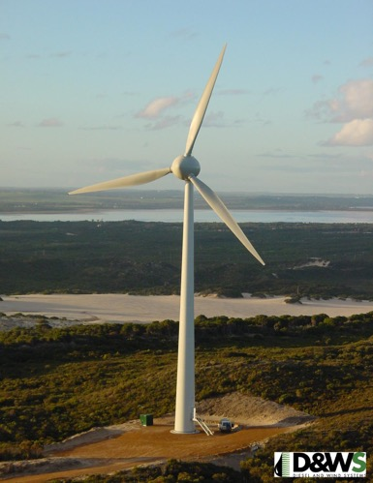
HAWT Turbines
HAWT = Horizontal Axis Wind Turbine
ADVANTAGES
DISADVANTAGES
Tall towers to reach higher wind speeds
Variable blade pitch, which gives the turbine blades the optimum angle of attack
High efficiency since blades always move perpendicular to the wind
Difficult to transport (20% of equipment costs)
Need very tall and expensive crane and skilled operators to install
Massive tower construction is required to support heavy blades, gearbox and generators
This is now the standard in the industry.
Image courtesy of Verve Energy
Notes:
HAWT = Horizontal Axis Wind Turbines
The most common turbine you see

Slide 12
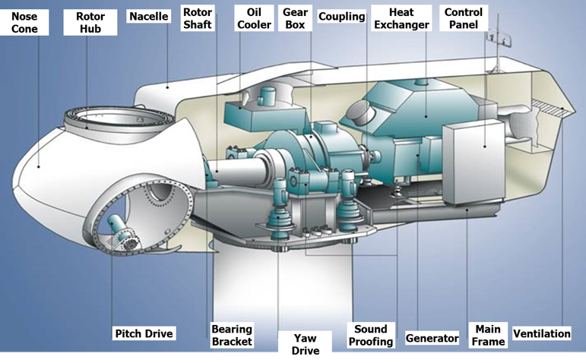
Gearbox Turbine
This is one type of gearbox found in a HAWT turbine
The gearbox increases the rotational speed of the rotor to a higher speed for the generator
The lifetime of a gearbox is 6-7 years. It is then swapped out with another gearbox
Notes:
A gearbox turbine contains a gearbox. This is used to increase the rotations per minute of the horizontal axis so that the generator can produce more elecricty.
Check out this website for more information on how a gearbox works.
https://www.windpowerengineering.com/mechanical/gearboxes/gears-gearboxes-101/

Slide 13
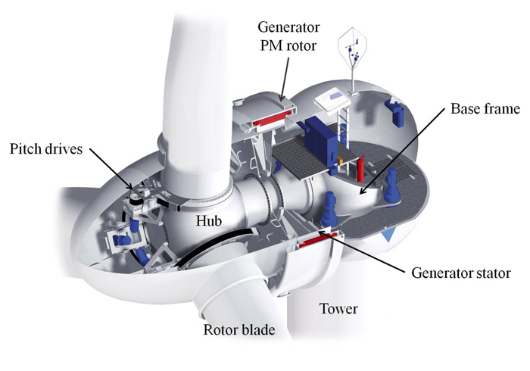
Direct Drive Turbine
Permanent magnet
This is another type found in a HAWT turbine
Most turbine manufacturers have migrated to this technology
A permanent magnet is inside the nacelle
An electric field is generated from the rotation of the blade
The electric field is converted to electricity by the generator
Notes:
This is a newer technology. Inside the nacelle, there is a permanent magnet. This is used to generate electricity at a lower rotation per minute (rpm). Unlike a gearbox turbine, the rpm is not increased.
For more information visit this website:
http://www.alxion.com/glossary/permanent-magnet-generator/

Slide 14
Turbine Components
Tower, nacelle, rotor and blades

Slide 15
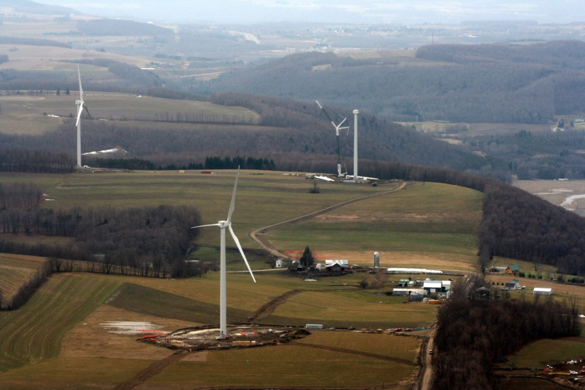
Turbine Technology
Turbine
Balance of Plant
  Foundations
  Collection System
  Access Roads
  Communication System
  Transformers
  Substation
Roads
Collection System
Notes:
To construct a wind farm, these components are required.
Balance of Plant (BOP) is all of the auxiliary components essential to the project that is not used to generate electricity. For example, foundation is essential to install and support a wind turbine.

Slide 16
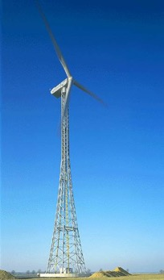
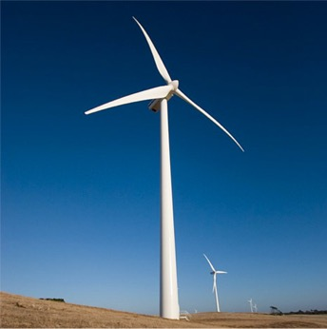
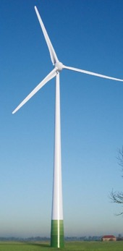
Towers
Lattice
Tubular (Steel)
Tubular (Precast Concrete)
Notes:
Lattice towers are no longer installed because of issues with birds nesting in the structure. Canada’s first wind farm was built with the lattice style tower. This wind farm was called Cowley Ridge, constructed in 1993, and decommissioned in 2016.
There are some towers that have lifts (small elevators) inside to move people up and down.

Slide 17
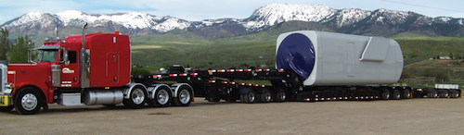
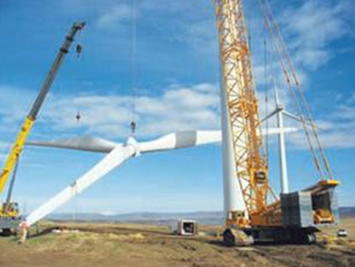
Nacelle and Rotor
Nacelle
  Holds drive train components including main frame, main shaft, gearbox and generator
  Heated and cooled
  Made of fiberglass and aluminum
Rotor
  Comprised of hub and blades
  Hub – made of cast iron and attaches the blades to main shaft
  Blades – made of composite materials and can be up to 55m long
Notes:
Nacelles are the size of a small bus. Some contain transformers – they hold over 6,000 parts.
The rotor includes the hub and the blades. The blades can be very long. The larger the rotor diameter, the higher the production.

Slide 18
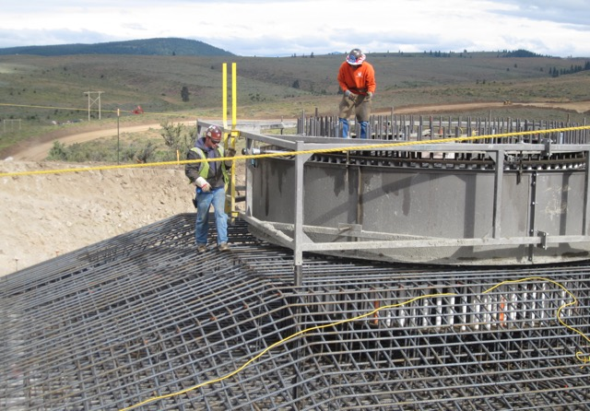
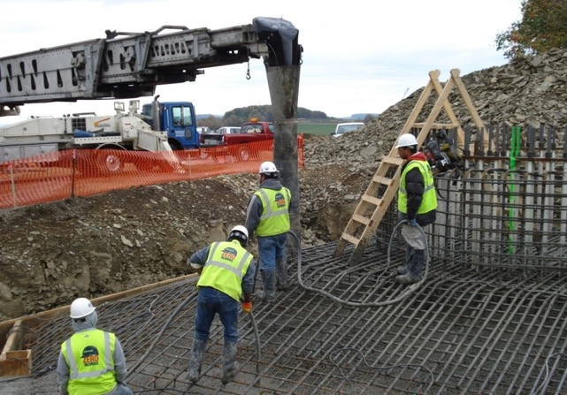
Foundation

Slide 19
Blades
Similar to an airplane wing
The high and low pressures are on opposite sides of the blade actually push and pull the rotor in a circle
Notes:
Picture source: http://www.alternative-energy-tutorials.com/energy-articles/wind-turbine-blade-design.html
Blades are a key component of a turbine as they are responsible for making the turbine spin and therefore energy generation.

Slide 20
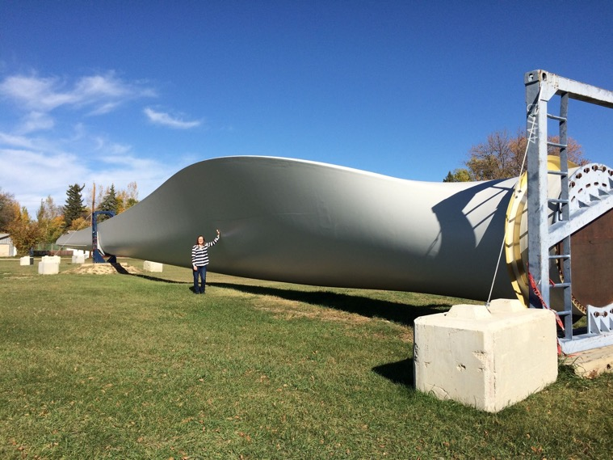
Size of a Turbine Blade
Notes:
This is a picture of a turbine blade that belongs to the Blackspring Ridge Wind Farm in Alberta.

Slide 21
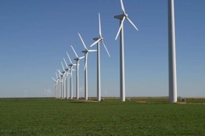
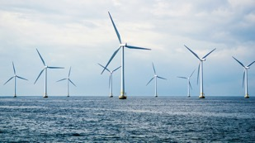
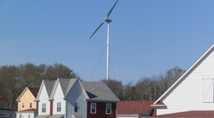
Types of Wind Power
Large | Onshore (utility-scale) > 100 kW Ground | Offshore >100 kW Water
Small | Distributed wind < 100 kW Ground | N/A
Notes:
There are three main types of wind power:
Utility-scale wind
- Turbines generate over 100 kilowatts of electricity! These are the large wind farms that supply electricity to our homes. They are located onshore (on the ground).
Offshore wind
- Turbines that are found in large bodies of water (i.e., the ocean). This is very common in European countries!
Distributed or “small” wind
- Turbines that generate under 100 kilowatts of energy. The electricity is directly used to power a home, farm or small business. This is called distributed wind because it can connect directly to the distribution grid, where as large scale connects to the transmission grid.
In Alberta, we have many onshore utility scale wind farms. The largest wind farms currently in operation are Blackspring Ridge, and Halkirk wind farms

Slide 22

The Evolution of Wind Turbine Sizes
Alberta’s Wind Turbine Sizes since 1993
130-141m
3450-4200kW
Rotor diameter (m)
Rating (kW)
101m
2300kW
80m
1800kW
Hub Height (m)
47m
660kW
33m
375kW
YEAR
Expected
Ref: Solas Energy Consulting
Notes:
As the picture shows, turbines have increased significantly in height since they first emerged in 1993. As the turbines increase in size, their capacity does as well. This means that more electricity can be generated from fewer turbines.
Technological improvements have allowed turbines to become bigger over time.
A higher tower means access to higher wind speeds
A larger rotor means more energy is generated

Slide 23
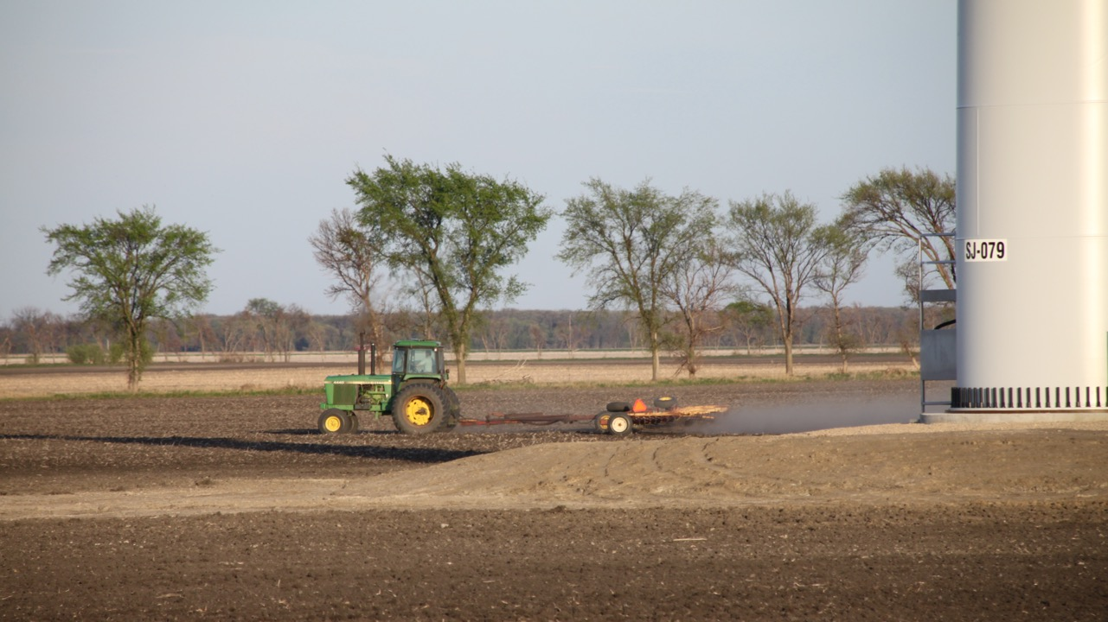
Size of a Turbine

Slide 24
How to Build a Wind Turbine

Slide 25
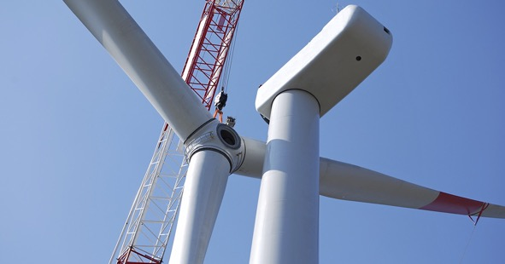
Time Lapse of a Wind Turbine Construction
From the Ground Up: Building our energy future, one turbine at a time – MidAmericanEnergyCo
  Published April 22, 2015
  This video is 5 min, 48 seconds
  All units are in imperial
https://www.youtube.com/watch?v=84BeVq2Jm88&feature=player_embedded
Notes:
This video is almost 6 minutes long. The video shows a time lapse of a wind turbine being constructed. It also provides information about each step in the installation process.

Slide 26
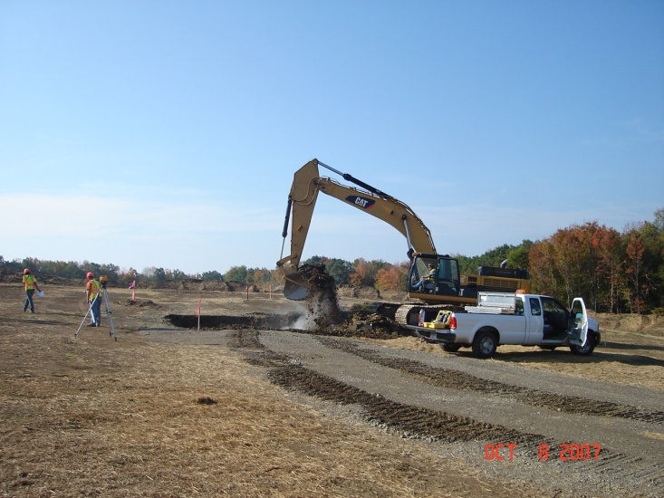
1. A large hole is dug out for the foundation

Slide 27
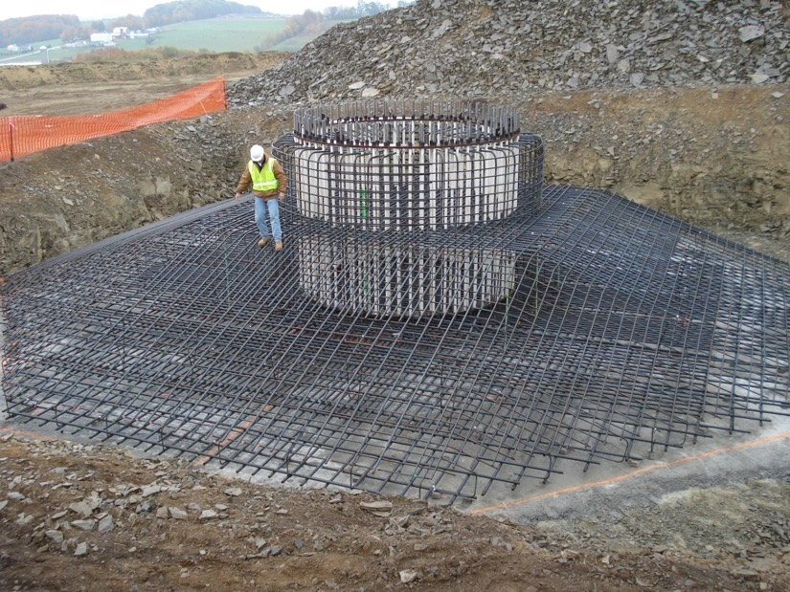
2. Foundation is laid

Slide 28
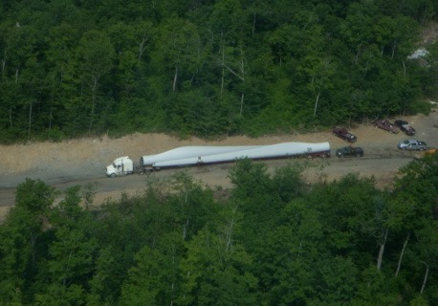
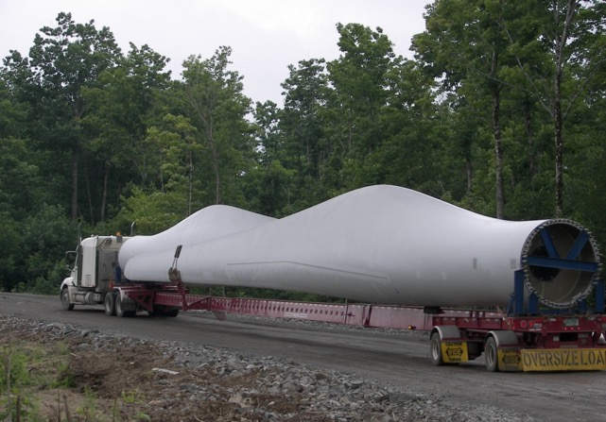
3. Blades are transported to the site
A single turbine blade is commonly 40 meters long!

Slide 29
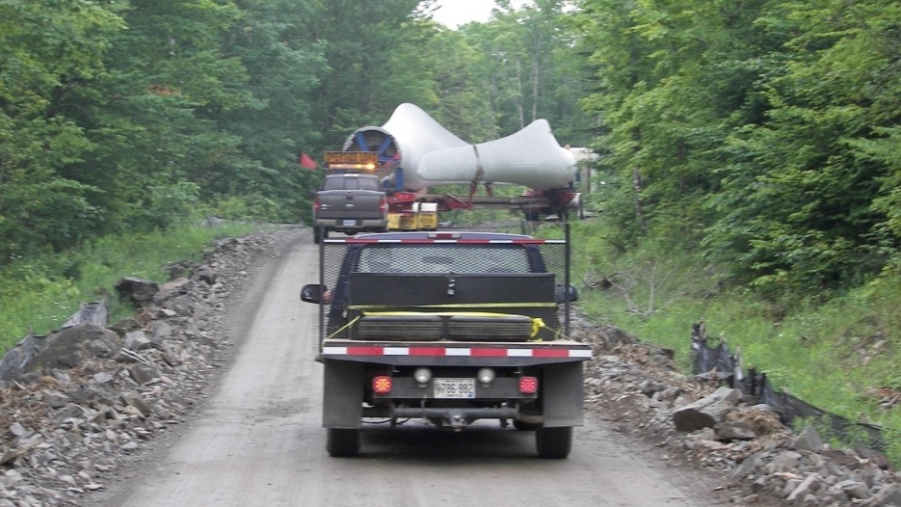
The long blades require caution during transportation as corners are difficult to navigate

Slide 30
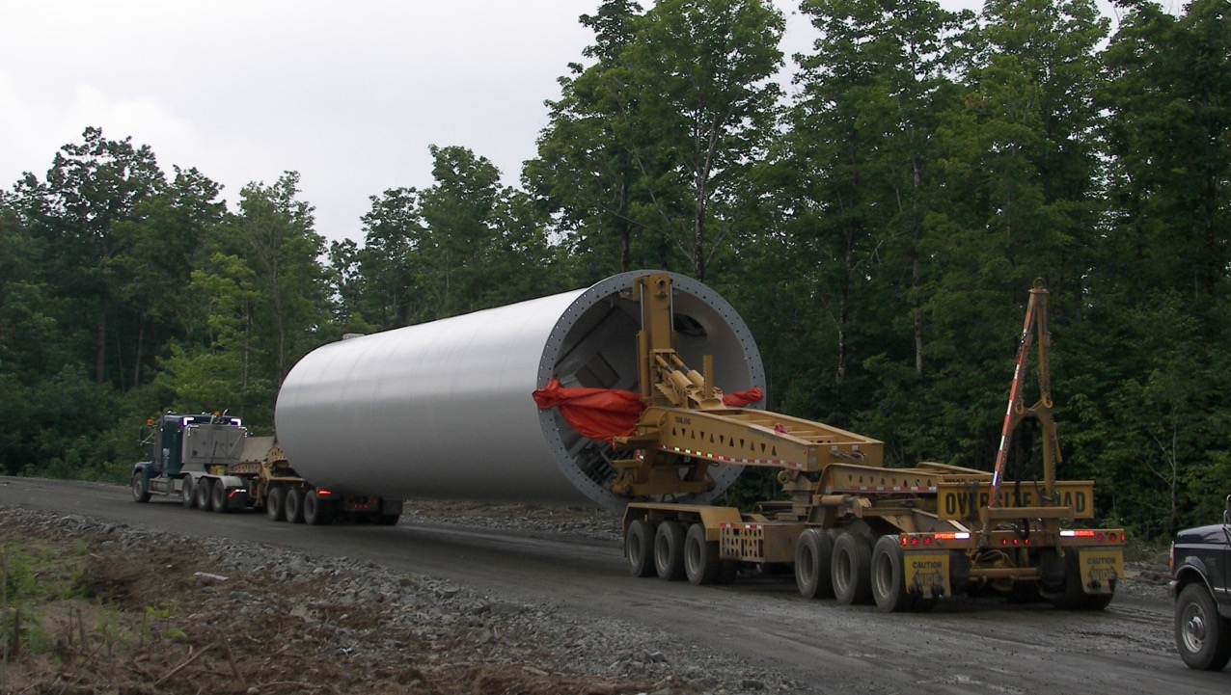


4. Tower sections are transported to the site
This photo shows one tower section being transported

Slide 31
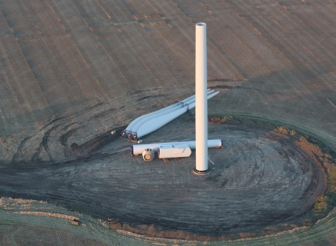
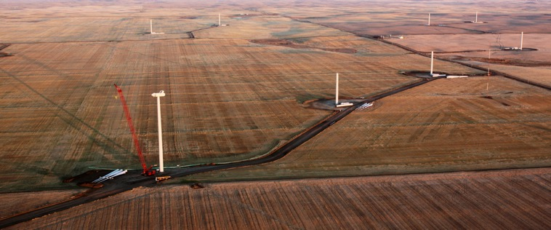
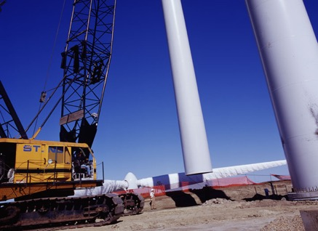
5. Installing the turbine

Slide 32
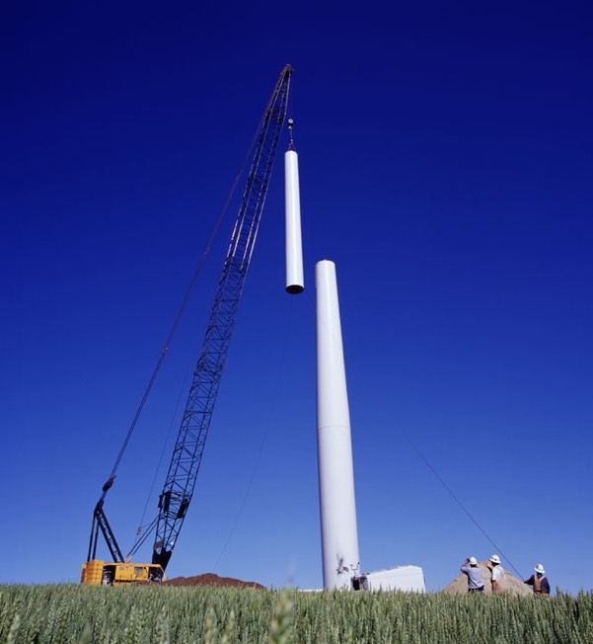
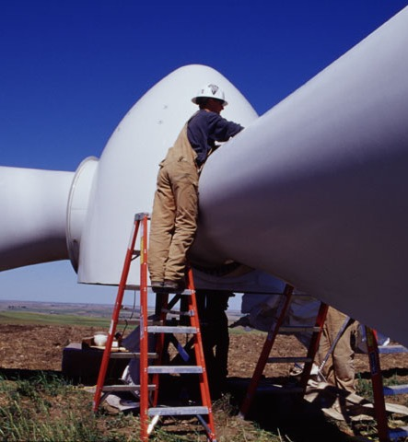

Slide 33
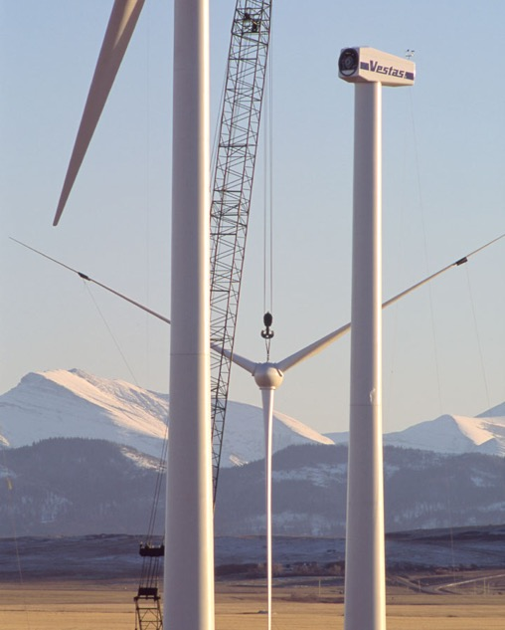
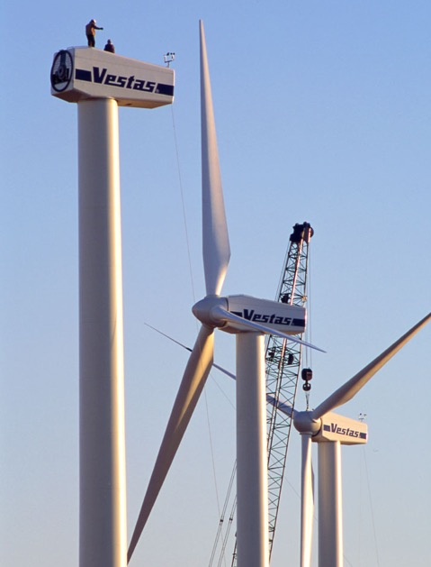

Slide 34
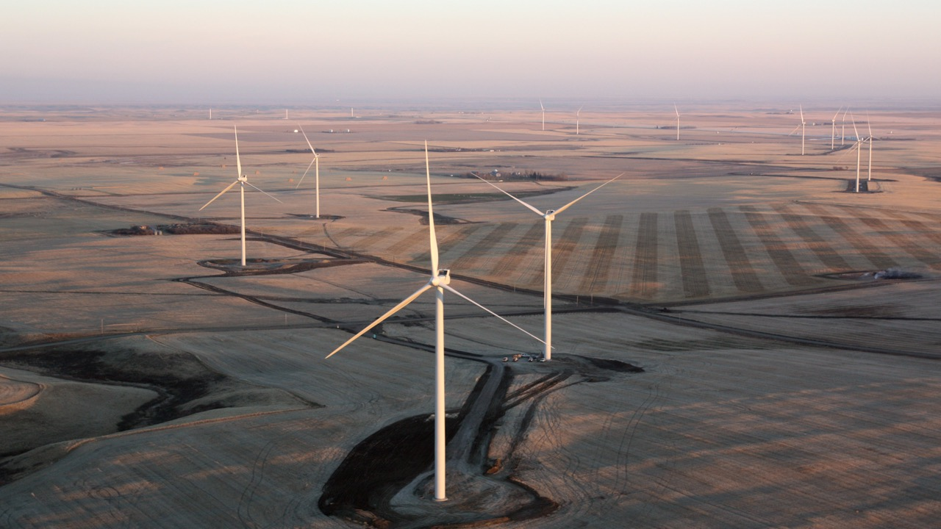
6. Completed Turbine and Wind Farm

Slide 35
Important Studies Before Construction
Environmental Studies:
  Birds and bats
  Vegetation
  Wetlands
Noise Studies:
  How loud will the turbines and substations be at nearby houses
Visual and Shadow Flicker Studies:
  How will the Wind Power Project look on the landscape
  Will the rotation of the blades create a strobe like effect and cause irritation to nearby homeowners

Slide 36
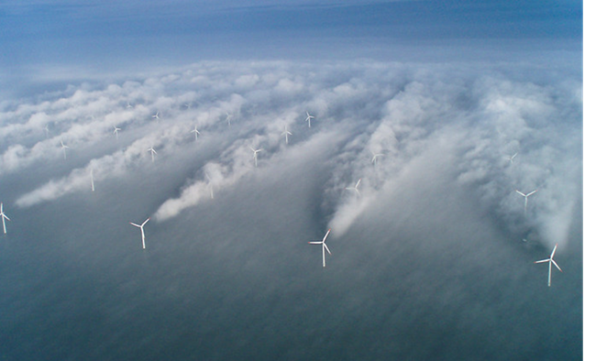
Design Considerations
Wake Losses: a wind turbine creates a wake, which is the turbulence downstream. This can impact the windspeed at the next turbine, and reduce the energy generation.
Notes:
As wind passes a turbine, turbulence can occur. This is called a wake effect. If turbines are aligned so that the wind from one turbines goes to the following turbines, wake losses can occur. This means that the second turbine gets wind at a lower speed. This can reduce the overall production of the wind farm as non-optimal wind speeds are obtained.

Slide 37
Wind Measurements
Met towers, SODAR, LIDAR

Slide 38
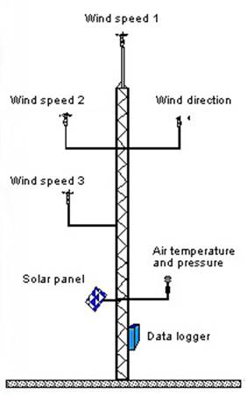
How is the Wind Resource Determined?
Meteorological (Met) Towers are used to measure the wind’s speed and direction, and air temperature and pressure
Met Towers
  There must be one met tower within 2 km of every proposed turbine location
  Multiple anemometers give a sense of the wind shear turbine blades may experience (i.e., the force and direction of wind exerted on turbine blades)
Met towers are 60 to 100 metres high!
It is ideal to leave met towers installed for 1 year to obtain sufficient data.
Notes:
Met towers are used to measure many properties of wind. The wind speed in measured at different heights as the wind speed changes at higher altitudes. Met towers are also equipped with devices to measure the wind direction and the air temperature and pressure. In the picture, a solar panel is present, which is used to power the measurement devices. The data logger collects all the data from the instruments to be analyzed by specialists later on. Met towers are a crucial part of wind power project development. Without sufficient data, the maximum productivity and generation may not be optimal.

Slide 39
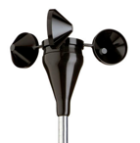
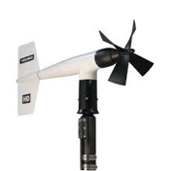
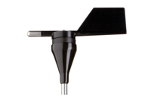
Met Towers Instruments
Tilt-up Meteorological Tower
  Uses the wind sensors shown
  Generally takes 2 – 3 days to construct and install a met tower
  Requires 2 - 3 acres of land to allow for guidewire placement
Cup Anemometer
Propeller Anemometer
Direction Vane
Measures wind speed
Measures wind direction
Notes:
These are some devices that are commonly installed on a met tower to conduct the wind resource studies. The two anemometers are used to measure the wind speeds. These are usually placed at different levels to get an accurate reading of how the wind speed changes with height. This will allow the analysts to determine the optimal turbine height.
A direction vane is used to determine the wind direction. This is important to to measure because it will help determine which direction the turbine should face. For the best generation, turbines should face into the wind.

Slide 40
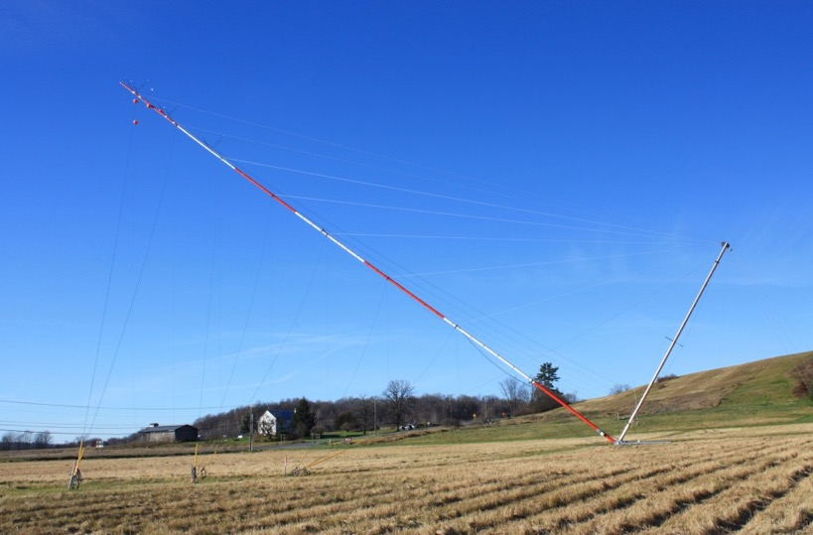

A Tilt-up Meteorological Tower
Guy Wires
This is what a met tower looks like. This met tower is in the process of being installed. When in place, It will stand straight up.
A truck is used to pull up the met tower
Gin Pole
Meteorological Tower
Notes:
This is a method of installation. The gin pole is pulled by a truck to raise the meteorological tower to its upright position. The guy wires hold the tower in place throughout the year.

Slide 41
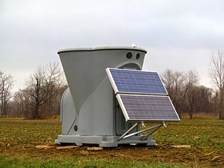
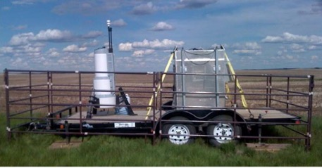
Other Types of Wind Measurement Devices
SODAR
LIDAR or LADAR
Measures wind speed and direction up to 200 m
Sends out a ‘chirp’, records the sound and measures how the sound is scattered
Light Detection and Ranging
Measures the distance to a point by illuminating the point with a pulsed laser. The device measured the reflected pulse
LIDAR can measure the wind speeds and wind turbulence
Notes:
These two devices can be used to obtain wind data in the preliminary steps of wind farm development.
SODAR uses noise for its measurements, whereas LIDAR uses laser lights.
Both measure the responses. SODAR measures how the sound scatters – echoes. LIDAR measures the reflection from the light.

Slide 42
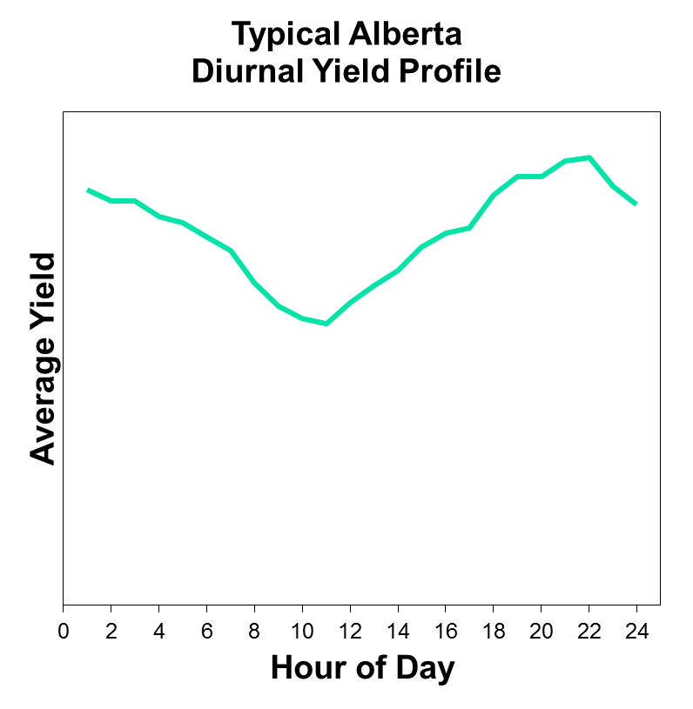
Production by Time of Day
Average production varies by time of day
Driven by heating and cooling of the Earth’s surface
Shear profile (change in wind velocity with height) also depends on temperature changes
‘Diurnal profile’ varies with height of turbine
Shape of the diurnal profile varies from site to site and by season
Notes:
This graph is what a typical yield profile (total possible production) would look like in the course of 24 hours. Although, there is a great deal of variability between sites and size of the turbine. Some regions may be significantly more windy than others, therefore increasing the yield. Additionally at higher heights, there is more wind, with greater wind speeds. This will also result in a larger yield.
However, generally speaking, there will be a greater in the early mornings and late nights. This characteristic is very complimentary to solar as the peak generation is during the day

Slide 43
WINTER
SPRING
Coal
Coal
Cogen
Cogen
ALBERTA’S GENERATION - 2015
FOUR DAYS, FOUR SEASONS
SUMMER
FALL
Coal
Coal
Cogen
Cogen
Hydro
Cogen
Coal
CCGT
SCGT
Wind
Notes:
This graph shows the supply and demand of electricity in Alberta energy over four (4) days of each season. This graph is from 2015. There are six sources of electricity generation in Alberta in 2015; hydro power, cogeneration (gas), coal, combined cycle gas turbine (CCGT) and simple cycle gas turbine (SCGT) and wind power. As you can see, coal is a major player in Alberta’s energy profile. The blue on this graph is wind. The peaks on the graph correlate to the power demand during the day, where there is peak energy demand. The size of each energy type shows how much energy each resource contributes to meeting this demand.
On each of these charts there is a weekend! Can you tell which day is the weekend? Also, notice how Alberta’s demand changes between the seasons, and what season has more wind power production.
Notice that cogeneration does not react to increases in the demand for electricity, but coal and CCGT are able to. Notice how SCGT is able to zip in and out and provide electricity as required. SCGT is the “humming bird” of the industry with quick starts and stops. Notice how wind power is not on or off, but rather moves as a fluid with gradual rises and gradual declines.

Slide 44
ACTIVITY – Wind turbine design challenge
See lesson plan (page 7) for instruction and handout

Slide 45
QUIZ!

Slide 46
Wind is…
Moving Clouds
Moving Trees
Moving Air
Notes:
Answer: C) Moving Air

Slide 47
Energy in wind comes from the…
Earth
Ocean
Sun
Notes:
Answer: B) Ocean

Slide 48
A tool that measures the SPEED of the wind is…
Anemometer
Thermometer
Weather Vane
Notes:
Answer: A) Anemometer

Slide 49
A tool that measures the DIRECTION of the wind is…
Anemometer
Weather Vane
Thermometer
Notes:
Answer: B) Weather Vane

Slide 50
A wind turbine uses energy to make…
Electricity
Heat
Flour
Notes:
Answer: A) Electricity

Slide 51
What part of the wind turbine captures the wind?
Tower
Nacelle
Blades
Notes:
Answer: C) Blades

Slide 52
Name the instruments at the indicated locations
B)
A)
Notes:
A) Anemometer
Can a student name the two types? Cup and propeller
B) Weather Vane

Slide 53
Recap!
Wind turbines are complex systems
Wind turbines are effective for electricity production
Wind turbines require studies and consultation prior to development
There are many careers associated to the development and operation of a wind farm
Alberta has strong wind potential and many opportunities for expansion

Slide 54
GreenLearning.ca Additional Resources
Re-Energy: http://www.greenlearning.ca/programs/re-energy/
Notes:
If you would like to learn more about this topic, visit the links above.

Slide 55
THANK YOU!
PEEL is supported by the Community Environment Action Program. This project is offered in partnership with GreenLearning Canada Foundation, provider of free online education programs about energy, climate change and green economy.

Slide 56
EXTENSIONS

Slide 57
Build Your Own Wind Turbine
Read the background information in the handout provided.
Task: Design and create a wind turbine that can lift a weight up 30 centimetres high.
You must research, plan, create, test, reflect/improve.
Make sure you meet the criteria listed on the handout
Research
Plan
Create
Test
Improve
Notes:
Teachers: show this video by TeacherGeek (7 min, 42 sec) to help them with ideas on how to build their turbine and what their turbine should do.

Slide 58
Research Questions
How do windmills and wind turbines work?
What parts will I need to have in my design? (Base, tower, blades, shaft, etc.)
What is the best angle (pitch) to have my blades at?
How will I convert wind energy (kinetic energy) into mechanical energy?
What simple machines could I use to help with my design? (Pulleys, gears, wheel and axle, lever)

